Slide 1
解讀關鍵組合語言II
Function Call and Calling conventions

Slide 2
函式呼叫

Slide 3
函式呼叫Function call
x86 calling conventions
不帶參數的函式呼叫
帶參數的函式呼叫
遞迴函式呼叫
https://en.wikipedia.org/wiki/X86_calling_conventions
#include<stdio.h>
#include<stdlib.h>
int function1(int a, int b);
int main(){
printf("The sum is %d\n",function1(11,21));
return 0;
}
int function1(int a, int b){
return a+b;
}
函式原型宣告
函式呼叫
Caller(呼叫者)
arguments
parameters
函式定義
Callee(被呼叫)

Slide 4
堆疊 Stack及其運算

Slide 5
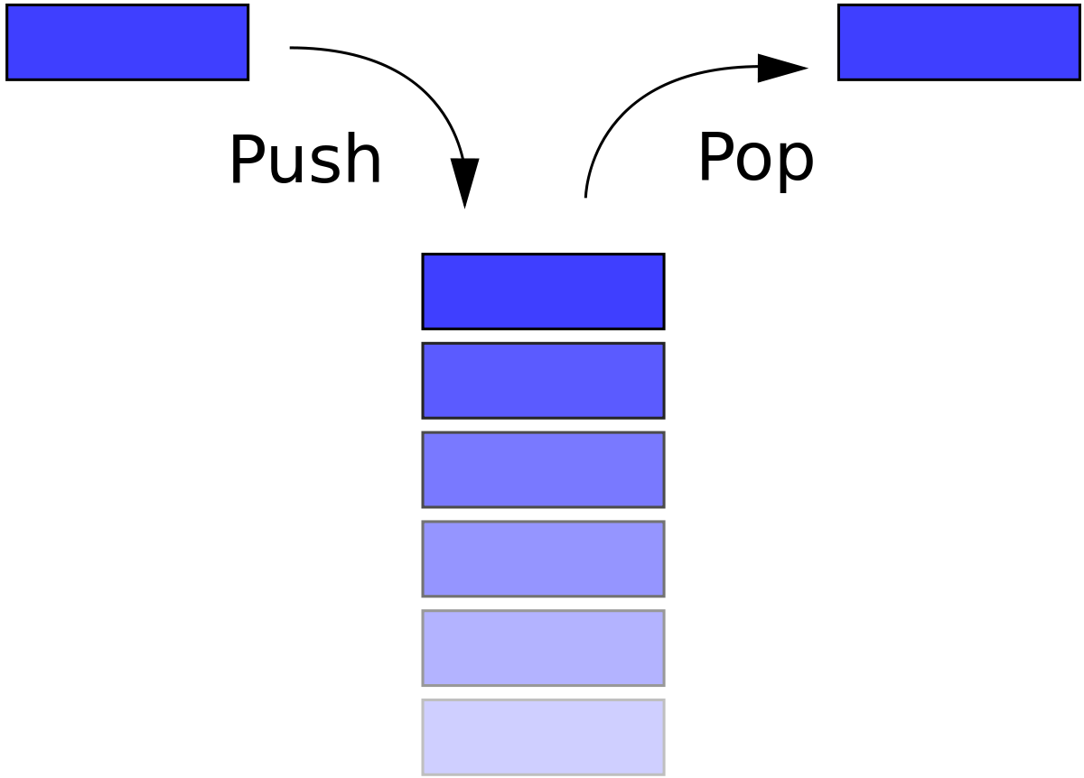
堆疊 Stack
https://en.wikipedia.org/wiki/Stack_(abstract_data_type)
The stack is a conceptual area of main memory (RAM) which is designated by the OS when a program is started.
Different OS start it at different addresses by convention
A stack is a Last-In-First-Out (LIFO/FILO) data structure where data is "pushed" on to the top of the stack and "popped" off the top.

Slide 6
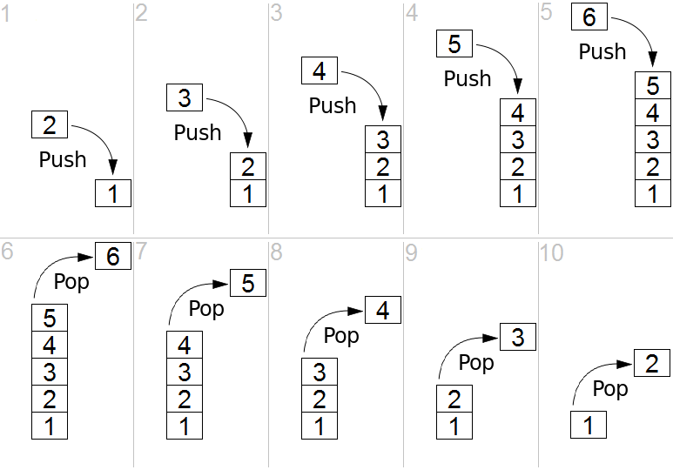

Stack運算::Push vs POP
堆積木

Slide 7
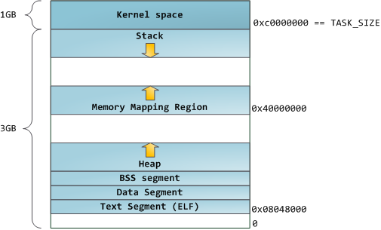
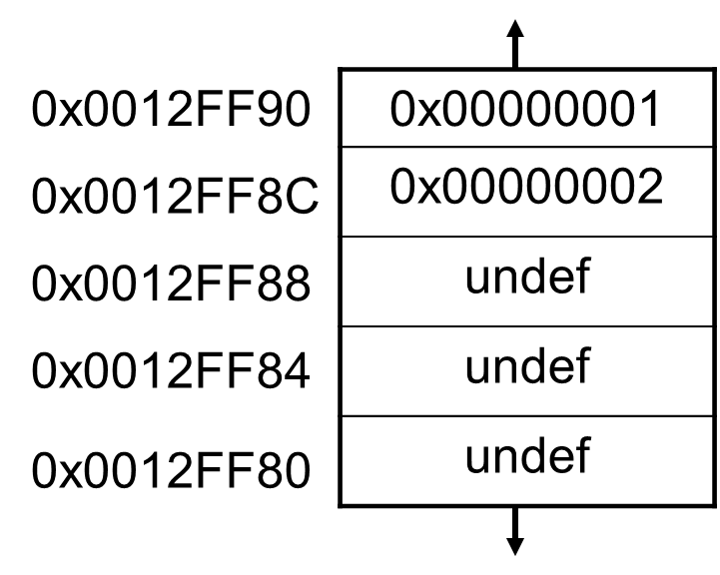
memory addresses
特別注意哪邊是高位址!!
high memory addresses
Kernel高高在上
eax
ebp
esp
ESP
EBP
堆疊::函式呼叫
區域變數,…..
Stack往低走
By convention the stack grows toward lower memory addresses
high memory addresses
堆積::動態記憶體配置
malloc(),…
EIP
low memory addresses
Adding something to the stack means the top of the stack is now at a lower memory address
low memory addresses

Slide 8
Push Word, Doubleword or Quadword onto the Stack
push eax
EAX
沒變
Registers Before
Registers After
eax | 0x00000003
esp | 0x0012FF88
eax | 0x00000003
esp | 0x0012FF8C
high memory addresses
0x0012FF90
0x00000001
0x00000002
undef
undef
undef
0x0012FF90
0x00000001
0x00000002
0x00000003
undef
undef
ESP
0x0012FF8C
0x0012FF8C
0x0012FF88
ESP
0x0012FF88
0x0012FF84
0x0012FF84
0x0012FF80
0x0012FF80
把 eax存的值壓入到
stack
low memory addresses
Stack Before
Stack After
esp points to the top of the stack, the lowest address which is being used

Slide 9
Registers Before
Registers After
eax | 0xFFFFFFFF
esp | 0x0012FF88
eax | 0x00000003
esp | 0x0012FF8C
pop eax
Pop a Value from the Stack
high memory addresses
0x0012FF90
0x00000001
0x00000002
0x00000003
undef
undef
0x0012FF90
0x00000001
0x00000002
undef(0x00000003)
undef
undef
0x0012FF8C
ESP
0x0012FF8C
ESP
0x0012FF88
0x0012FF88
0x0012FF84
0x0012FF84
0x0012FF80
0x0012FF80
把stack TOP(最低位址處)資料減下貼上到 eax
Stack Before
Stack After

Slide 10
Function Call and Calling conventions

Slide 11
calling conventions
調用約定calling conventions
描述了被調用代碼的接口：
原子(純量)參數，或複雜參數獨立部分的分配順序;
參數是如何被傳遞的(放置在堆疊上，或是暫存器中，亦或兩者混合);
被調用者(callee)應保存調用者(caller)的哪個暫存器;
調用函數時如何為任務準備堆疊，以及任務完成如何恢復;
https://en.wikipedia.org/wiki/X86_calling_conventions#List_of_x86_calling_conventions

Slide 12
cdecl(C declaration,C聲明)
源起C語言的一種調用約定，也是C語言的事實上的標準。
在x86架構上，其內容包括：
函數實參在執行緒棧上按照從右至左的順序依次壓棧。
函數結果保存在暫存器EAX/AX/AL中
浮點型結果存放在暫存器ST0中
編譯後的函數名前綴以一個下劃線字符
調用者caller負責從執行緒棧中彈出實參（即清棧）
8比特或者16比特長的整形實參提升為32比特長。
受到函數調用影響的暫存器（volatile registers）：EAX, ECX, EDX, ST0 - ST7, ES, GS
不受函數調用影響的暫存器： EBX, EBP, ESP, EDI, ESI, CS, DS
RET指令從函數被調用者callee返回到調用者caller（實質上是讀取暫存器EBP所指的執行緒棧之處保存的函數返回地址並加載到IP暫存器）

Slide 13
x86 Disassembly/Calling Conventions
https://en.wikibooks.org/wiki/X86_Disassembly/Calling_Conventions
CDECL calling convention
Arguments are passed on the stack in Right-to-Left order, and return values are passed in eax.
The calling function cleans the stack. This allows CDECL functions to have variable-length argument lists (aka variadic functions). For this reason the number of arguments is not appended to the name of the function by the compiler, and the assembler and the linker are therefore unable to determine if an incorrect number of arguments is used.
_MyFunction1:
push ebp
mov ebp, esp
mov eax, [ebp + 8]
mov edx, [ebp + 12]
add eax, edx
pop ebp
ret
_cdecl int MyFunction1(int a, int b)
{
return a + b;
}
push 3
push 2
call _MyFunction1
add esp, 8
x = MyFunction1(2, 3);

Slide 14
x86 Disassembly/Calling Conventions
https://en.wikibooks.org/wiki/X86_Disassembly/Calling_Conventions
STDCALL(“WINAPI“) calling convention::Microsoft
STDCALL passes arguments right-to-left, and returns the value in eax. (The Microsoft documentation erroneously claimed that arguments are passed left-to-right, but this is not the case.)
The called function cleans the stack, unlike CDECL. This means that STDCALL doesn't allow variable-length argument lists.
:_MyFunction2@8
push ebp
mov ebp, esp
mov eax, [ebp + 8]
mov edx, [ebp + 12]
add eax, edx
pop ebp
ret 8
_cdecl int MyFunction2(int a, int b)
{
return a + b;
}
In the function body, the ret instruction has an (optional) argument that indicates how many bytes to pop off the stack when the function returns.
push 3
push 2
call _MyFunction2@8
x = MyFunction2(2, 3);

Slide 15
cdecl(C declaration,C聲明)
https://zh.wikipedia.org/wiki/X86%E8%B0%83%E7%94%A8%E7%BA%A6%E5%AE%9A
Function prologues函數頭
caller:
; make new call frame
push ebp
mov ebp, esp
; push call arguments
push 3
push 2
push 1
; call subroutine 'callee'
call callee
; remove arguments from frame
add esp, 12
; use subroutine result
add eax, 5
; restore old call frame
pop ebp
; return
ret
int callee(int, int, int);
int caller(void)
{
int ret;
ret = callee(1, 2, 3);
ret += 5;
return ret;
}
被調用者(callee)執行結果
儲存在EAX暫存器
function epilogues函數尾

Slide 16
Function prologues函數頭
https://en.wikipedia.org/wiki/Function_prologue
A function prologue typically does the following actions if the architecture has a base pointer (also known as frame pointer) and a stack pointer:
Pushes current base pointer onto the stack, so it can be restored later.
Assigns the value of stack pointer (which is pointed to the saved base pointer) to base pointer so that a new stack frame will be created on top of the old stack frame.
Moves the stack pointer further by decreasing or increasing its value, depending on whether the stack grows down or up. On x86, the stack pointer is decreased to make room for the function's local variables.
push ebp
mov ebp, esp
sub esp, N
The N immediate value is the number of bytes reserved on the stack for local use
The same result may be achieved by using the enter instruction:
enter N, 0

Slide 17
function epilogues函數尾
Function epilogue reverses the actions of the function prologue and returns control to the calling function. It typically does the following actions (this procedure may differ from one architecture to another):
Drop the stack pointer to the current base pointer, so room reserved in the prologue for local variables is freed.
Pops the base pointer off the stack, so it is restored to its value before the prologue.
Returns to the calling function, by popping the previous frame's program counter off the stack and jumping to it.
mov esp, ebp
pop ebp
ret
the x86 processor contains a built-in instruction which performs part of the epilogue. The following code is equivalent to the above code
leave
ret

Slide 18
函式呼叫
不傳參數
Introduction to Intel x86 Assembly, Architecture, Applications, & Alliteration
http://www.opensecuritytraining.info/IntroX86_files/IntroductionToIntelx86-Part1.pdf

Slide 19
objdump -D -M intel -j .text funcall --no-show-raw-insn
00000560 <sub>:
560: push ebp
561: mov ebp,esp
563: call 58d <__x86.get_pc_thunk.ax>
568: add eax,0x1a98
56d: mov eax,0xbeef
572: pop ebp
573: ret
00000574 <main>:
574: push ebp
575: mov ebp,esp
577: call 58d <__x86.get_pc_thunk.ax>
57c: add eax,0x1a84
581: call 560 <sub>
586: mov eax,0xf00d
58b: pop ebp
58c: ret
Function prologues函數頭
gcc funcall.c -o funcall -g
function epilogues函數尾
#include <stdio.h>
int sub(){
return 0xbeef;
}
int main(){
sub();
return 0xf00d;
}
Function prologues函數頭
function epilogues函數尾

Slide 20
STACK FRAME
https://en.wikipedia.org/wiki/Call_stack
sub
push ebp
mov ebp, esp
mov eax, 0BEEFh
pop ebp
ret
main
push ebp
mov ebp, esp
call _sub
mov eax, 0F00Dh
pop ebp
ret
“Function-before-
main”'s frame
high memory addresses
0x004012E8 
main's frame
(saved frame pointer
and saved return address)
0x0012FF6C
0x0012FFB8
0x00401018
0x0012FF68
undef
undef
0x0012FF68
0x0012FF64
sub's frame
(only saved frame pointer,
because it doesn't call
anything else, and doesn't
have local variables)
0x0012FF60
0x0012FF5C
0x0012FF58
low memory addresses

Slide 21
Example1.c
The stack frames in this example will be very simple.
Only saved frame pointer (ebp) and saved return addresses (eip).
//Example1 - using the stack
//to call subroutines
//New instructions:
//push, pop, call, ret, mov
int sub(){
return 0xbeef;
}
int main(){
sub();
return 0xf00d;
}
sub:
00401000 push ebp
00401001 mov ebp,esp
00401003 mov eax,0BEEFh
00401008 pop ebp
00401009 ret
main:
00401010 push ebp
00401011 mov ebp,esp
00401013 call sub (401000h)
00401018 mov eax,0F00Dh
0040101D pop ebp
0040101E ret
http://www.opensecuritytraining.info/IntroX86_files/IntroductionToIntelx86-Part1.pdf

Slide 22
Example1.c 1: EIP = 00401010, but no instruction yet executed
EBP
eax | 0x003435C0 
ebp | 0x0012FFB8 
esp | 0x0012FF6C 
Key:
 executed instruction,
 modified value
 start value
Belongs to the frame *before* main() is called
sub:
00401000 push ebp
00401001 mov ebp,esp
00401003 mov eax,0BEEFh
00401008 pop ebp
00401009 ret
main:
00401010 push ebp
00401011 mov ebp,esp
00401013 call sub (401000h)
00401018 mov eax,0F00Dh
0040101D pop ebp
0040101E ret
ESP
0x0012FF6C
0x004012E8 
0x0012FF68
undef
undef
undef
undef
undef
0x0012FF64
0x0012FF60
EIP
0x0012FF5C
0x0012FF58
low memory addresses

Slide 23
Example1.c 2
eax | 0x003435C0 
ebp | 0x0012FFB8 
esp | 0x0012FF68 
Key:
 executed instruction,
 modified value
 start value
EBP
sub:
00401000 push ebp
00401001 mov ebp,esp
00401003 mov eax,0BEEFh
00401008 pop ebp
00401009 ret
main:
00401010 push ebp 
00401011 mov ebp,esp
00401013 call sub (401000h)
00401018 mov eax,0F00Dh
0040101D pop ebp
0040101E ret
0x004012E8 
0x0012FF6C
ESP
0x0012FF68
0x0012FFB8 
undef
undef
undef
undef
0x0012FF64
0x0012FF60
EIP
0x0012FF5C
0x0012FF58

Slide 24
Example1.c 3
eax | 0x003435C0 
ebp | 0x0012FF68 
esp | 0x0012FF68
Key:
 executed instruction,
 modified value
 start value
sub:
00401000 push ebp
00401001 mov ebp,esp
00401003 mov eax,0BEEFh
00401008 pop ebp
00401009 ret
main:
00401010 push ebp
00401011 mov ebp,esp 
00401013 call sub (401000h)
00401018 mov eax,0F00Dh
0040101D pop ebp
0040101E ret
0x0012FF6C
0x004012E8 
EBP
ESP
0x0012FF68
0x0012FFB8
undef
undef
undef
undef
0x0012FF64
0x0012FF60
EIP
0x0012FF5C
0x0012FF58

Slide 25
Example1.c 4
eax | 0x003435C0 
ebp | 0x0012FF68
esp | 0x0012FF64 
Key:
 executed instruction,
 modified value
 start value
sub:
00401000 push ebp
00401001 mov ebp,esp
00401003 mov eax,0BEEFh
00401008 pop ebp
00401009 ret
main:
00401010 push ebp
00401011 mov ebp,esp
00401013 call sub (401000h) 
00401018 mov eax,0F00Dh
0040101D pop ebp
0040101E ret
0x0012FF6C
0x004012E8 
EBP
0x0012FF68
0x0012FFB8
0x00401018 
undef
undef
undef
ESP
0x0012FF64
0x0012FF60
EIP
0x0012FF5C
0x0012FF58
將Return address壓入stack

Slide 26
Example1.c 5
Key:
 executed instruction,
 modified value
 start value
eax | 0x003435C0 
ebp | 0x0012FF68
esp | 0x0012FF60 
sub:
00401000 push ebp 
00401001 mov ebp,esp
00401003 mov eax,0BEEFh
00401008 pop ebp
00401009 ret
main:
00401010 push ebp
00401011 mov ebp,esp
00401013 call sub (401000h)
00401018 mov eax,0F00Dh
0040101D pop ebp
0040101E ret
0x0012FF6C
0x004012E8 
EIP
EBP
0x0012FF68
0x0012FFB8
0x00401018
0x0012FF68 
undef
undef
0x0012FF64
ESP
0x0012FF60
0x0012FF5C
0x0012FF58

Slide 27
Example1.c 6
Key:
 executed instruction,
 modified value
 start value
eax | 0x003435C0 
ebp | 0x0012FF60 
esp | 0x0012FF60
sub:
00401000 push ebp
00401001 mov ebp,esp 
00401003 mov eax,0BEEFh
00401008 pop ebp
00401009 ret
main:
00401010 push ebp
00401011 mov ebp,esp
00401013 call sub (401000h)
00401018 mov eax,0F00Dh
0040101D pop ebp
0040101E ret
0x0012FF6C
0x004012E8 
EIP
0x0012FF68
0x0012FFB8
0x00401018
0x0012FF68
undef
undef
0x0012FF64
EBP
ESP
0x0012FF60
0x0012FF5C
0x0012FF58

Slide 28
Example1.c 7
Key:
 executed instruction,
 modified value
 start value
eax | 0x0000BEEF
ebp | 0x0012FF60
esp | 0x0012FF60
sub:
00401000 push ebp
00401001 mov ebp,esp
00401003 mov eax,0BEEFh 
00401008 pop ebp
00401009 ret
main:
00401010 push ebp
00401011 mov ebp,esp
00401013 call sub (401000h)
00401018 mov eax,0F00Dh
0040101D pop ebp
0040101E ret
0x0012FF6C
0x004012E8 
0x0012FF68
0x0012FFB8
0x00401018
0x0012FF68
undef
undef
EIP
0x0012FF64
EBP
ESP
0x0012FF60
0x0012FF5C
0x0012FF58

Slide 29
Example1.c 8
eax | 0x0000BEEF
ebp | 0x0012FF68 
esp | 0x0012FF64 
Key:
 executed instruction,
 modified value
 start value
sub:
00401000 push ebp
00401001 mov ebp,esp
00401003 mov eax,0BEEFh
00401008 pop ebp 
00401009 ret
main:
00401010 push ebp
00401011 mov ebp,esp
00401013 call sub (401000h)
00401018 mov eax,0F00Dh
0040101D pop ebp
0040101E ret
0x0012FF6C
0x004012E8 
EBP
0x0012FF68
0x0012FFB8
0x00401018
undef 
undef
undef
EIP
ESP
0x0012FF64
0x0012FF60
0x0012FF5C
0x0012FF58

Slide 30
Example1.c 9
eax | 0x0000BEEF
ebp | 0x0012FF68
esp | 0x0012FF68 
Key:
 executed instruction,
 modified value
 start value
sub:
00401000 push ebp
00401001 mov ebp,esp
00401003 mov eax,0BEEFh
00401008 pop ebp
00401009 ret 
main:
00401010 push ebp
00401011 mov ebp,esp
00401013 call sub (401000h)
00401018 mov eax,0F00Dh
0040101D pop ebp
0040101E ret
0x0012FF6C
0x004012E8 
ESP
EBP
0x0012FF68
0x0012FFB8
undef 
undef
undef
undef
EIP
0x0012FF64
0x0012FF60
0x0012FF5C
0x0012FF58

Slide 31
Example1.c 9
eax | 0x0000F00D 
ebp | 0x0012FF68
esp | 0x0012FF68
Key:
 executed instruction,
 modified value
 start value
sub:
00401000 push ebp
00401001 mov ebp,esp
00401003 mov eax,0BEEFh
00401008 pop ebp
00401009 ret
main:
00401010 push ebp
00401011 mov ebp,esp
00401013 call sub (401000h)
00401018 mov eax,0F00Dh 
0040101D pop ebp
0040101E ret
0x0012FF6C
0x004012E8 
ESP
EBP
0x0012FF68
0x0012FFB8
undef
undef
undef
undef
0x0012FF64
0x0012FF60
0x0012FF5C
EIP
0x0012FF58

Slide 32
Example1.c 10
eax | 0x0000F00D
ebp | 0x0012FFB8 
esp | 0x0012FF6C 
Key:
 executed instruction,
 modified value
 start value
EBP
sub:
00401000 push ebp
00401001 mov ebp,esp
00401003 mov eax,0BEEFh
00401008 pop ebp
00401009 ret
main:
00401010 push ebp
00401011 mov ebp,esp
00401013 call sub (401000h)
00401018 mov eax,0F00Dh
0040101D pop ebp 
0040101E ret
ESP
0x0012FF6C
0x004012E8 
0x0012FF68
undef 
undef
undef
undef
undef
0x0012FF64
0x0012FF60
0x0012FF5C
EIP
0x0012FF58

Slide 33
Example1.c 11
Key:
 executed instruction,
 modified value
 start value
eax | 0x0000F00D
ebp | 0x0012FFB8
esp | 0x0012FF70 
EBP
ESP
sub:
00401000 push ebp
00401001 mov ebp,esp
00401003 mov eax,0BEEFh
00401008 pop ebp
00401009 ret
main:
00401010 push ebp
00401011 mov ebp,esp
00401013 call sub (401000h)
00401018 mov eax,0F00Dh
0040101D pop ebp
0040101E ret 
0x0012FF6C
undef 
0x0012FF68
undef
undef
undef
undef
undef
0x0012FF64
0x0012FF60
0x0012FF5C
EIP
0x0012FF58
Execution would continue at the value ret
removed from the stack: 0x004012E8

Slide 34
Example1 Notes
sub() is deadcode - its return value is not used for anything, and main always returns 0xF00D. If optimizations are turned on in the compiler, it would remove sub()
Because there are no input parameters to sub(), there is no difference whether we compile as cdecl vs stdcall calling conventions

Slide 35
函式呼叫
傳參數還有區域變數
Introduction to Intel x86 Assembly, Architecture, Applications, & Alliteration
以上次黃俊穎教授上課的範例

Slide 36
objdump -D -M intel -j .text add2 --no-show-raw-insn
000005c8 <main>:
5c8: lea ecx,[esp+0x4]
5cc: and esp,0xfffffff0
5cf: push DWORD PTR [ecx-0x4]
5d2: push ebp
5d3: mov ebp,esp
5d5: push ebx
5d6: push ecx
5d7: sub esp,0x10
5da: call 470 <__x86.get_pc_thunk.bx>
5df: add ebx,0x1a21
5e5: mov DWORD PTR [ebp-0xc],0x2
5ec: mov DWORD PTR [ebp-0x10],0x3
5f3: push DWORD PTR [ebp-0x10]
5f6: push DWORD PTR [ebp-0xc]
5f9: call 5a0 <add>
5fe: add esp,0x8
601: sub esp,0x8
604: push eax
605: lea eax,[ebx-0x1950]
60b: push eax
60c: call 400 <printf@plt>
611: add esp,0x10
614: mov eax,0x0
619: lea esp,[ebp-0x8]
61c: pop ecx
61d: pop ebx
61e: pop ebp
61f: lea esp,[ecx-0x4]
622: ret
#include <stdio.h>
int add(int x, int y)
{
int sum = 0;
sum += x;
sum += y;
return sum;
}
int main()
{
int a = 2, b = 3;
printf(“%d\n”,add(a, b) );
return 0;
}
000005a0 <add>:
5a0: push ebp
5a1: mov ebp,esp
5a3: sub esp,0x10
5a6: call 623 <__x86.get_pc_thunk.ax>
5ab: add eax,0x1a55
5b0: mov DWORD PTR [ebp-0x4],0x0
5b7: mov eax,DWORD PTR [ebp+0x8]
5ba: add DWORD PTR [ebp-0x4],eax
5bd: mov eax,DWORD PTR [ebp+0xc]
5c0: add DWORD PTR [ebp-0x4],eax
5c3: mov eax,DWORD PTR [ebp-0x4]
5c6: leave
5c7: ret

Slide 37
objdump -D -M intel -j .text add2 --no-show-raw-insn
000005c8 <main>:
5c8: lea ecx,[esp+0x4]
5cc: and esp,0xfffffff0
5cf: push DWORD PTR [ecx-0x4]
5d2: push ebp
5d3: mov ebp,esp
5d5: push ebx
5d6: push ecx
5d7: sub esp,0x10
5da: call 470 <__x86.get_pc_thunk.bx>
5df: add ebx,0x1a21
5e5: mov DWORD PTR [ebp-0xc],0x2
5ec: mov DWORD PTR [ebp-0x10],0x3
5f3: push DWORD PTR [ebp-0x10]
5f6: push DWORD PTR [ebp-0xc]
5f9: call 5a0 <add>
#include <stdio.h>
int add(int x, int y)
{
int sum = 0;
sum += x;
sum += y;
return sum;
}
int main()
{
int a = 2, b = 3;
printf(“%d\n”,add(a, b) );
return 0;
}

Slide 38
objdump -D -M intel -j .text add2 --no-show-raw-insn
main函數呼叫
000005a0 <add>:
5a0: push ebp
5a1: mov ebp,esp
5a3: sub esp,0x10
5a6: call 623 <__x86.get_pc_thunk.ax>
5ab: add eax,0x1a55
5b0: mov DWORD PTR [ebp-0x4],0x0
5b7: mov eax,DWORD PTR [ebp+0x8]
5ba: add DWORD PTR [ebp-0x4],eax
5bd: mov eax,DWORD PTR [ebp+0xc]
5c0: add DWORD PTR [ebp-0x4],eax
5c3: mov eax,DWORD PTR [ebp-0x4]
5c6: leave
5c7: ret
#include <stdio.h>
int add(int x, int y)
{
int sum = 0;
sum += x;
sum += y;
return sum;
}
int main()
{
int a = 2, b = 3;
printf(“%d\n”,add(a, b) );
return 0;
}
Function prologues函數頭
區域變數sum齣值設定
先取得x值並存到EAX
執行sum += x;
先取得y值並存到EAX
執行sum += x;
把最後函數執行結果存到EAX
function epilogues函數尾
返回main函數

Slide 39
#include<stdio.h>
#include<stdlib.h>
int function1(int a, int b);
int main(){
printf("The sum is %d\n",function1(11,21));
return 0;
}
int function1(int a, int b){
return a+b;
}
gcc -o fcall_ch10 fcall_ch10.c -g
gcc -S -masm=intel
fcall_ch10.c -o fcall_ch11.s
-fno-asynchronous-unwind-tables

Slide 40
解讀關鍵組合語言
main:
printf("The sum is %d\n",function1(11,21));
lea ecx, 4[esp]
and esp, -16
push DWORD PTR -4[ecx]
push ebp
mov ebp, esp
push ebx
push ecx
call __x86.get_pc_thunk.bx
add ebx, OFFSET FLAT:_GLOBAL_OFFSET_TABLE_
sub esp, 8
push 21
push 11
call function1
add esp, 16
sub esp, 8
push eax
lea eax, .LC0@GOTOFF[ebx]
push eax
call printf@PLT
add esp, 16
mov eax, 0
lea esp, -8[ebp]
pop ecx
pop ebx
pop ebp
lea esp, -4[ecx]
ret
function1(11,21));
.LC0:
.string "The sum is %d\n"

Slide 41
解讀關鍵組合語言
int function1(int a, int b){
return a+b;
}
被調用者(callee)
function1:
push ebp
mov ebp, esp
call __x86.get_pc_thunk.ax
add eax, OFFSET FLAT:_GLOBAL_OFFSET_TABLE_
mov edx, DWORD PTR 8[ebp]
mov eax, DWORD PTR 12[ebp]
add eax, edx
pop ebp
ret
被調用者(callee)執行結果
儲存在EAX暫存器
RET指令從函數被調用者callee返回到調用者caller
（實質上是讀取暫存器EBP所指的執行緒棧之處保存的函數返回地址並加載到IP暫存器）

Slide 42
解讀關鍵組合語言
objdump -S -j .text -M intel fcall_ch10 --no-show-raw-insn
000005a0 <main>:
#include<stdio.h>
#include<stdlib.h>
int function1(int a, int b);
int main(){
5a0: lea ecx,[esp+0x4]
5a4: and esp,0xfffffff0
5a7: push DWORD PTR [ecx-0x4]
5aa: push ebp
5ab: mov ebp,esp
5ad: push ebx
5ae: push ecx
5af: call 470 <__x86.get_pc_thunk.bx>
5b4: add ebx,0x1a4c
printf("The sum is %d\n",function1(11,21));
5ba: sub esp,0x8
5bd: push 0x15
5bf: push 0xb
5c1: call 5eb <function1>
5c6: add esp,0x10
5c9: sub esp,0x8
5cc: push eax
5cd: lea eax,[ebx-0x1970]
5d3: push eax
5d4: call 400 <printf@plt>
5d9: add esp,0x10
return 0;
5dc: mov eax,0x0
}

Slide 43
解讀關鍵組合語言
int function1(int a, int b){
return a+b;
}
}
5e1: lea esp,[ebp-0x8]
5e4: pop ecx
5e5: pop ebx
5e6: pop ebp
5e7: lea esp,[ecx-0x4]
5ea: ret
000005eb <function1>:
int function1(int a, int b){
5eb: push ebp
5ec: mov ebp,esp
5ee: call 602 <__x86.get_pc_thunk.ax>
5f3: add eax,0x1a0d
return a+b;
5f8: mov edx,DWORD PTR [ebp+0x8]
5fb: mov eax,DWORD PTR [ebp+0xc]
5fe: add eax,edx
}
600: pop ebp
601: ret

Slide 44
遞迴函式(recursive)
函式呼叫

Slide 45
遞迴函式(recursive) n!
int function factorial(int n)
{
if(n ==0)
return 1;
else
return n * factorial(n-l);
}

